Slide 1
14TH ANNUAL INTERNATIONAL SEMINAR OF MARKPATENT.ORG ON INTELLECTUAL PROPERTY RIGHTS
INTELLECTUAL PROPERTY RIGHTS A KEY TO SUCCESSFUL BUSINESS STRATEGY
Patenting in Europe through national route - tools for a successful strategy - the Italian experience

Slide 2
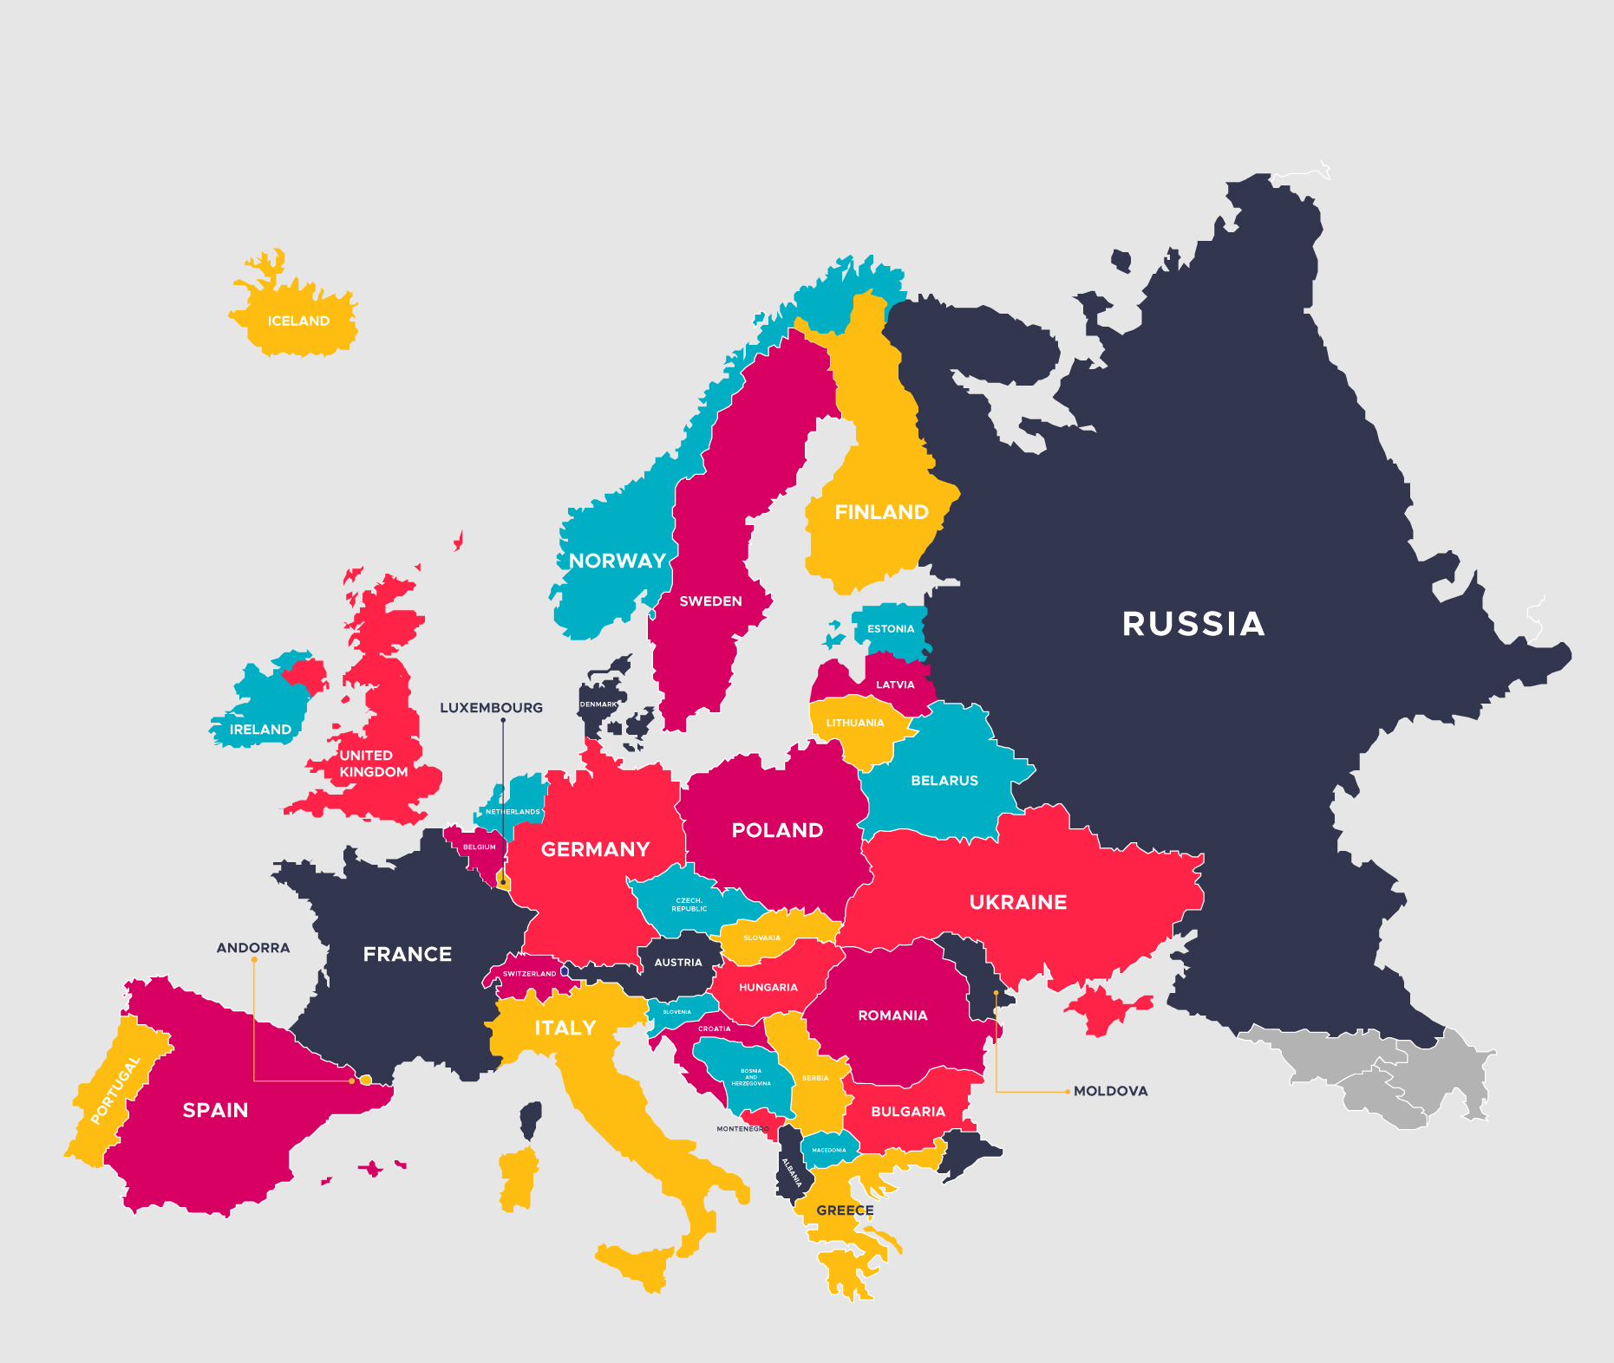
European Continent
Credits: <a href="https://www.freepik.com/free-photos-vectors/travel">Travel vector created by freepik - www.freepik.com</a>

Slide 3
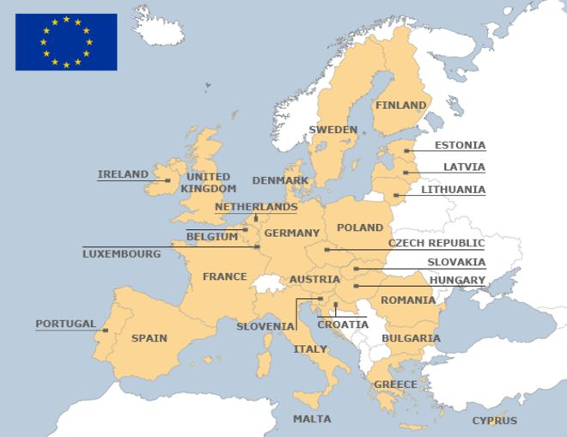
European Union

Slide 4
European Patents

Slide 5
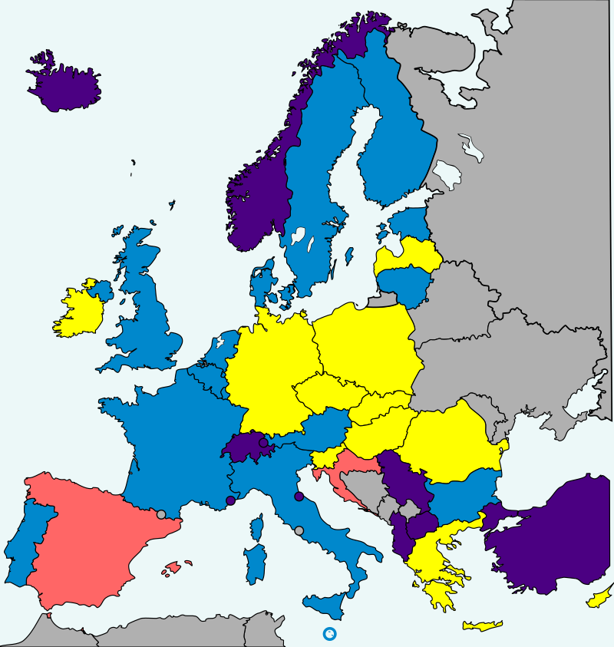
Unitary Patent System UPC ratification
Credits: By L.tak - File:EUpatent.svg, CC BY-SA 3.0, https://commons.wikimedia.org/w/index.php?curid=34060999

Slide 6
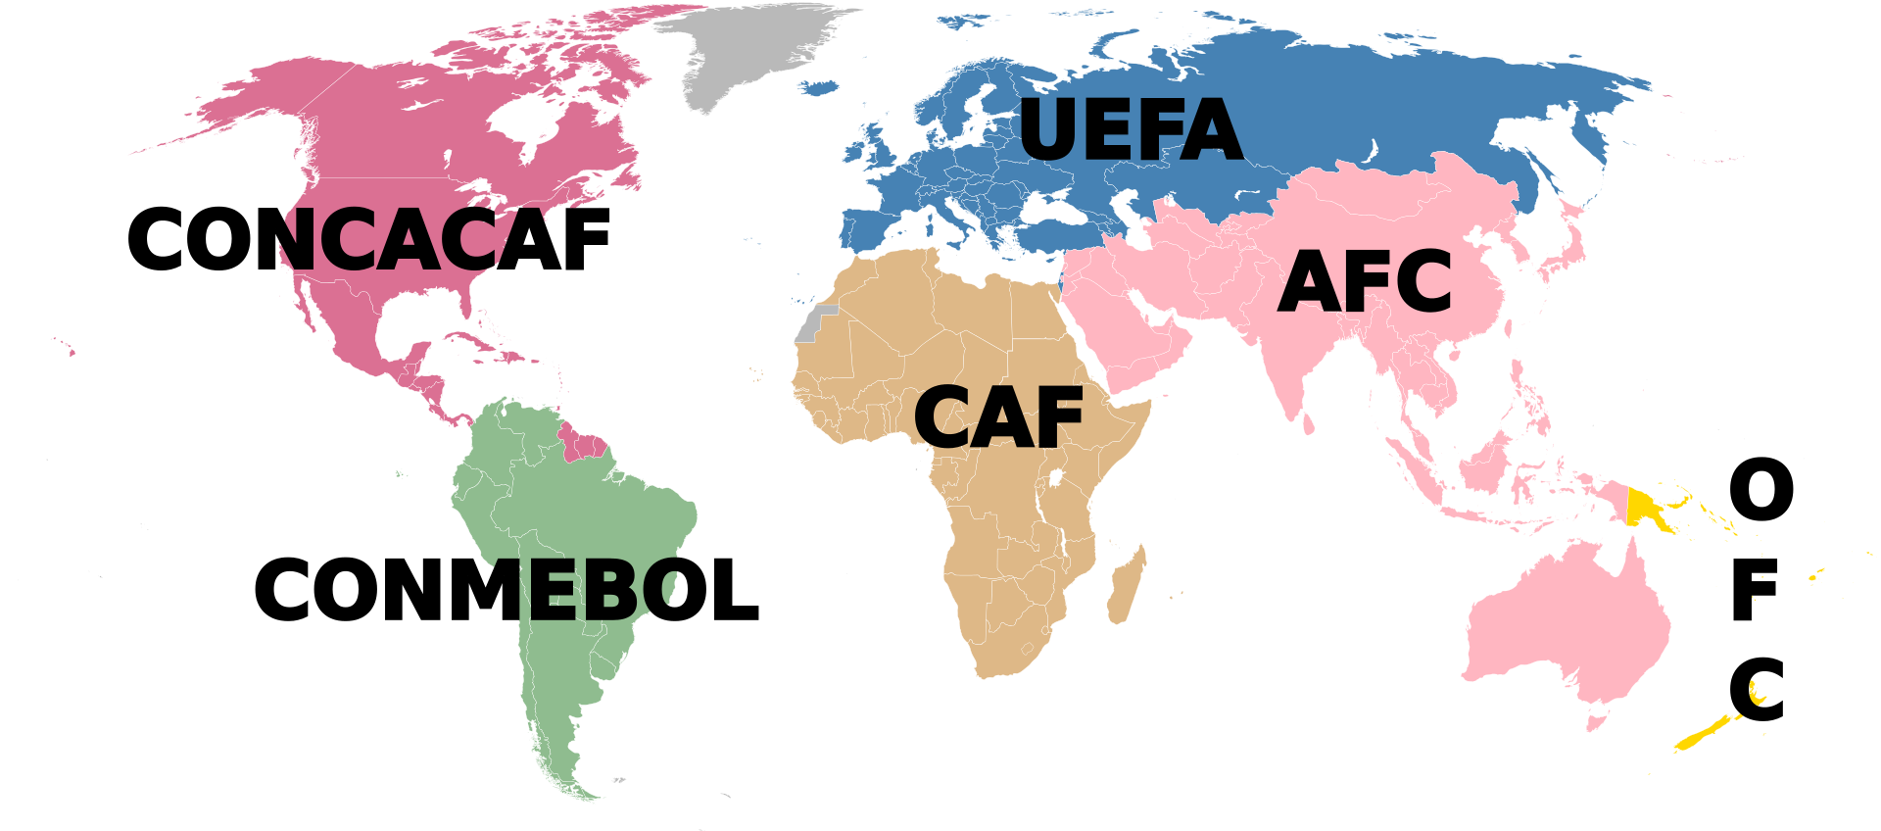
Union of European Football Associations (UEFA)
Credits: Di EOZyo - Based on Image:BlankMap-World6,_compact.svg, Pubblico dominio, https://commons.wikimedia.org/w/index.php?curid=4821652

Slide 7
Patenting in Europe
European Patents
Bundle of patents
Unitary patent
National patents
Utility Models

Slide 8
Country | European Union | EPO | Utility Model¹
Albania | No | Yes | Yes
Austria | Yes | Yes | Yes
Belgium | Yes | Yes | No
Bulgaria | Yes | Yes | Yes
Croatia | Yes | Yes | Yes
Cyprus | Yes | Yes | No
Czech Rep. | Yes | Yes | Yes
Denmark | Yes | Yes | Yes
Estonia | Yes | Yes | Yes
Finland | Yes | Yes | Yes
France | Yes | Yes | Yes
Germany | Yes | Yes | Yes
Greece | Yes | Yes | Yes
Hungary | Yes | Yes | Yes
Iceland | No | Yes | No
Ireland | Yes | Yes | Yes
Italy | Yes | Yes | Yes
Latvia | Yes | Yes | No
Liechtenstein | No | Yes | No
Lithuania | Yes | Yes | No
Luxemburg | Yes | Yes | No
¹ Source WIPO

Slide 9
Country | European Union | EPO | Utility Model¹
Former Yugoslav | No | Yes | No
Rep. of Macedonia | No | Yes | No
Malta | Yes | Yes | No
Monaco | No | Yes | No
Netherlands | Yes | Yes | No
Norway | No | Yes | No
Poland | Yes | Yes | Yes
Portugal | Yes | Yes | Yes
Romania | Yes | Yes | Yes
San Marino | No | Yes | No
Serbia | No | Yes | Yes
Slovakia | Yes | Yes | Yes
Slovenia | Yes | Yes | Yes
Spain | Yes | Yes | Yes
Sweden | Yes | Yes | No
Switzerland | No | Yes | No
Turkey | No | Yes | Yes
United Kingdom | Yes/No | Yes | No
¹ Source WIPO

Slide 10
National Route 1st filing in Italy
1st Filing – no priority (any language)
Search (by EPO) 8-9 months
Search Report & Opinion (by EPO)

Slide 11
S.R. & Opinon Sample record 1/3

Slide 12
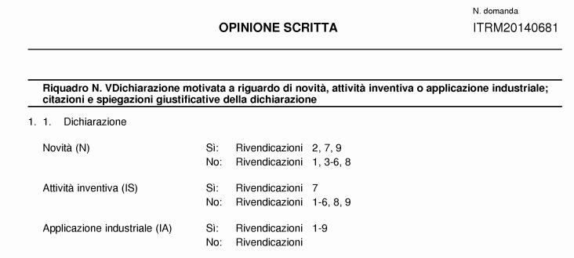
S.R. & Opinon Sample record 2/3

Slide 13
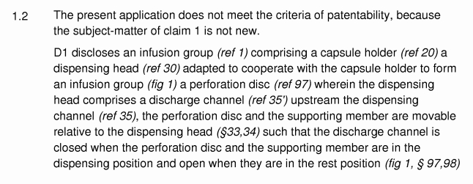
S.R. & Opinon Sample record 3/3

Slide 14
National Route prosecution in Italy
Application available to the public
Reply to Opinion
Limitations 2,5 Y
Integrations
Divisional(s)
Grant

Slide 15
Claiming Italian priority
European Patent Application (21 – 84 % refund of S.F.)
Application acc. to the PCT (25 – 100 % refund of S.F.)
Additional Nat. Filing

Slide 16
Facts and figures Italy
National filings (pat. for inventions) 10000/Y
National filings (Ut. Models) 2000/Y
Validations of EP 40000/Y

Slide 17
Facts and figures EPO Italian representatives
EPO filings (Indian applicants) 800/Y¹
Italian representatives 40/Y
¹ Source: Clarivate Analytics (year 2016)

Slide 19
Thank You

